Slide 1

Tracing Semantic Variation in Slang
Zhewei Sun and Yang Xu
Department of Computer Science
University of Toronto

Slide 2
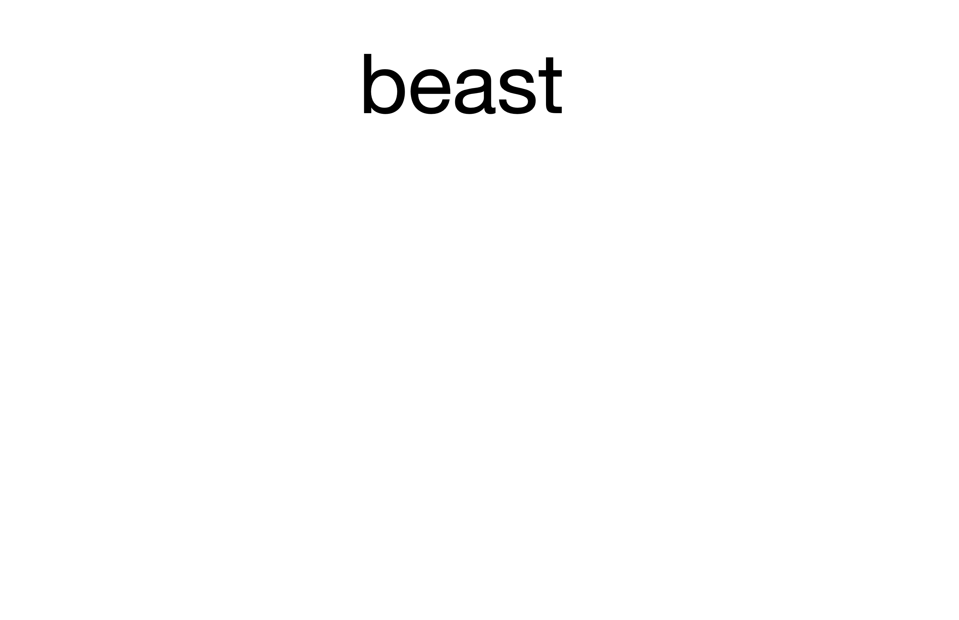
Semantic variation in slang
Slang detection (Pei et al., 2019):
That car is really beast.
Generation and interpretation (Ni and Wang, 2017; Sun et al., 2020, 2021):
beast ←→ “Excellent”.

Slide 3
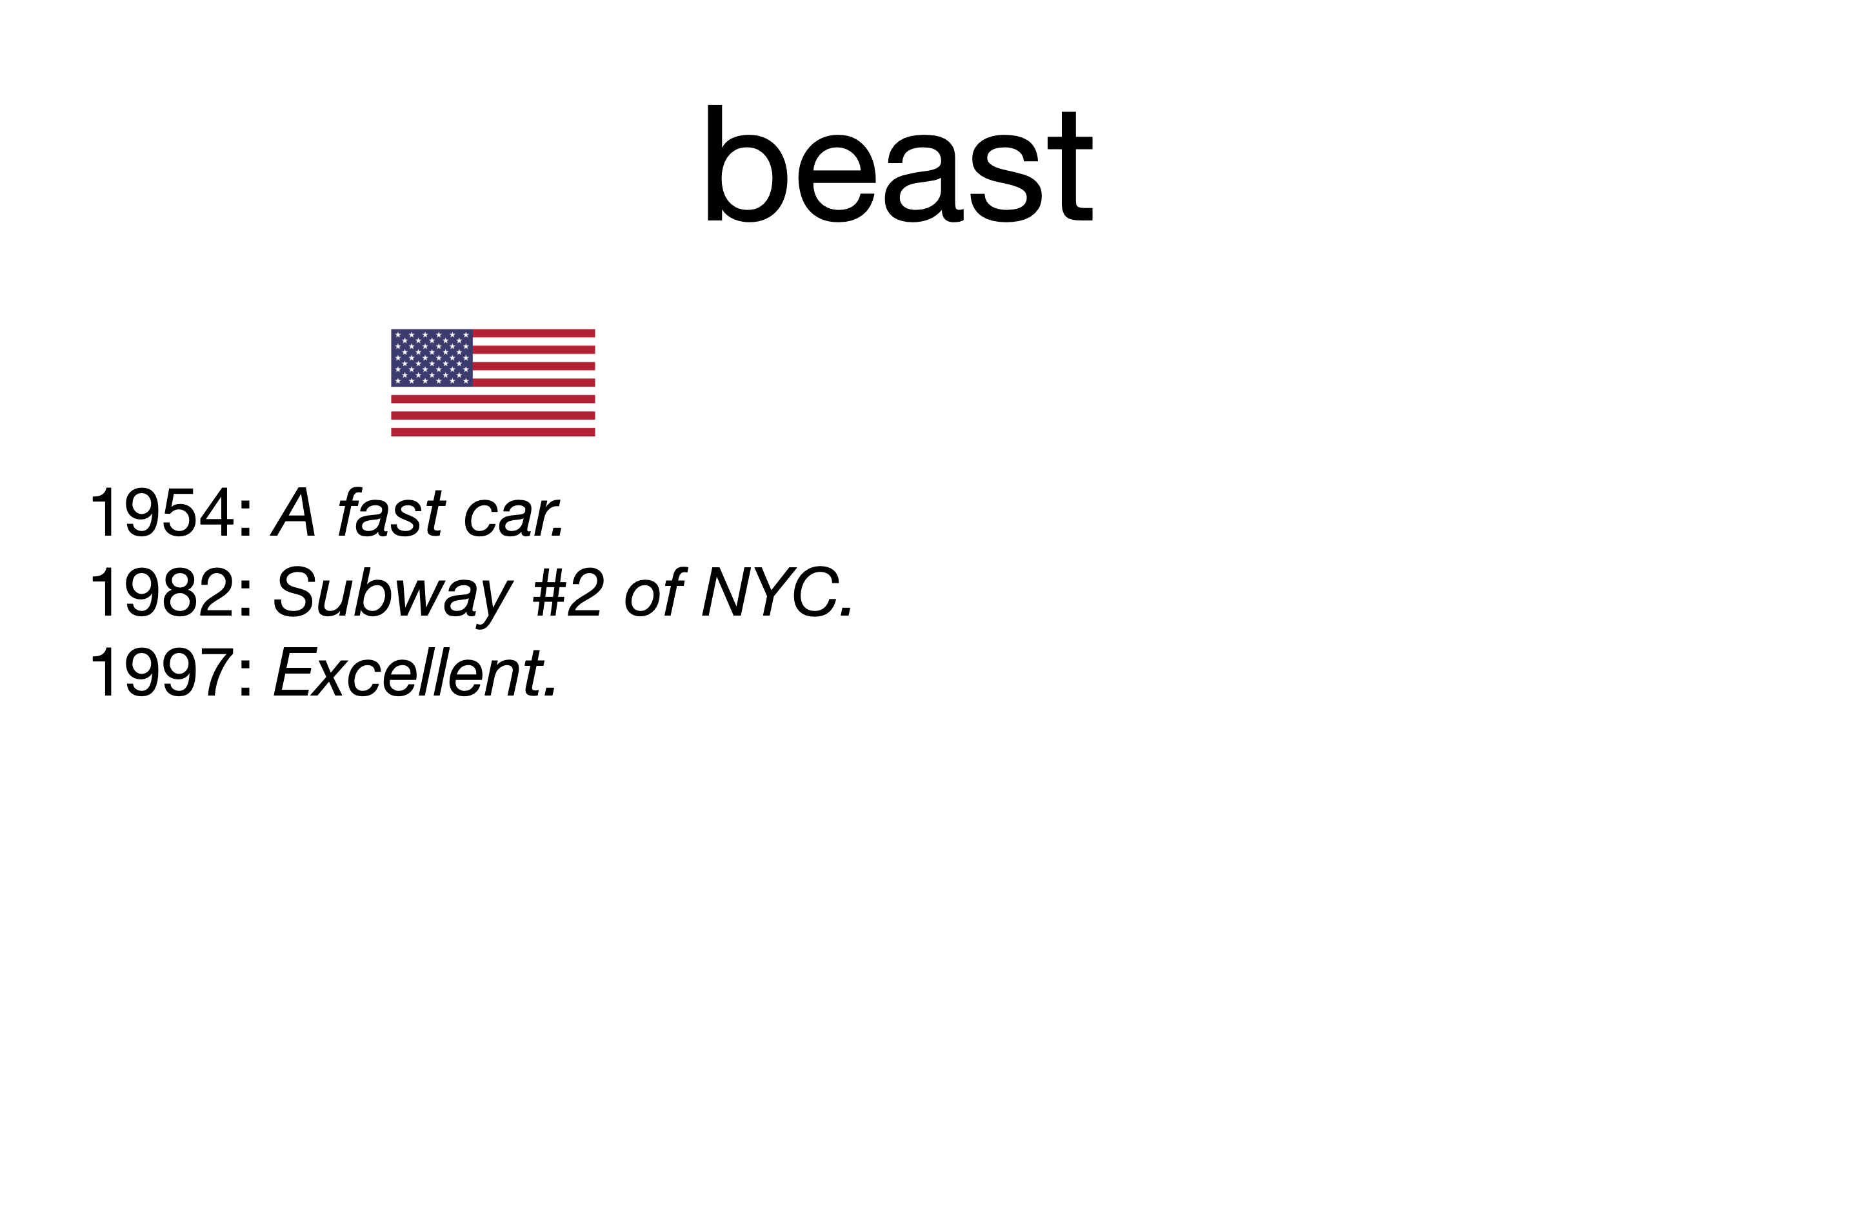
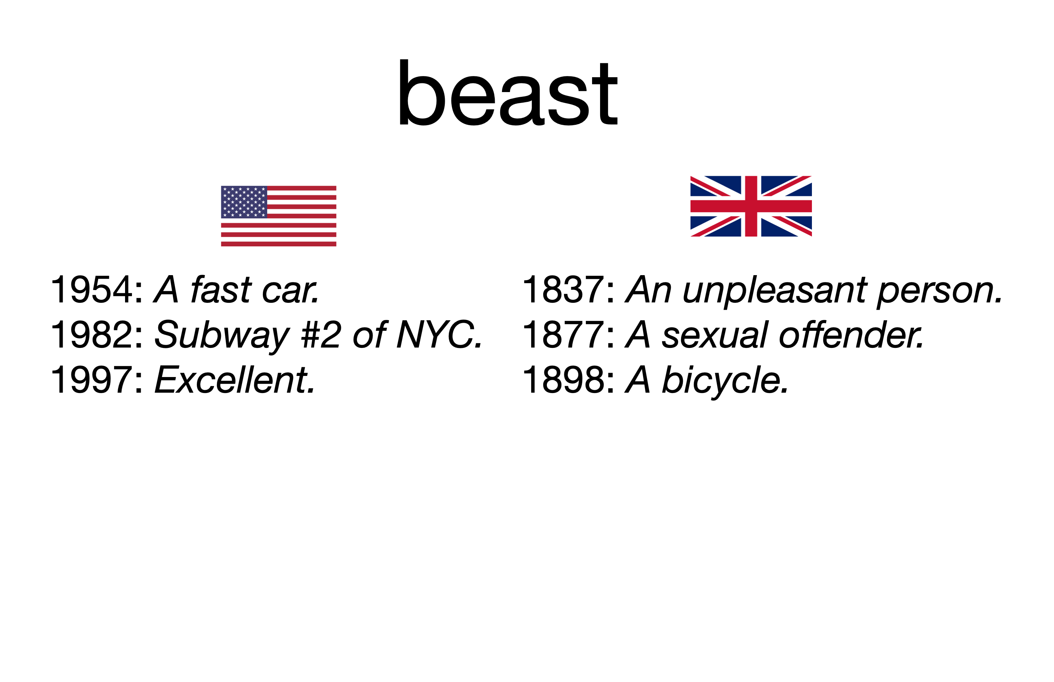
Semantic variation in slang

Slide 4
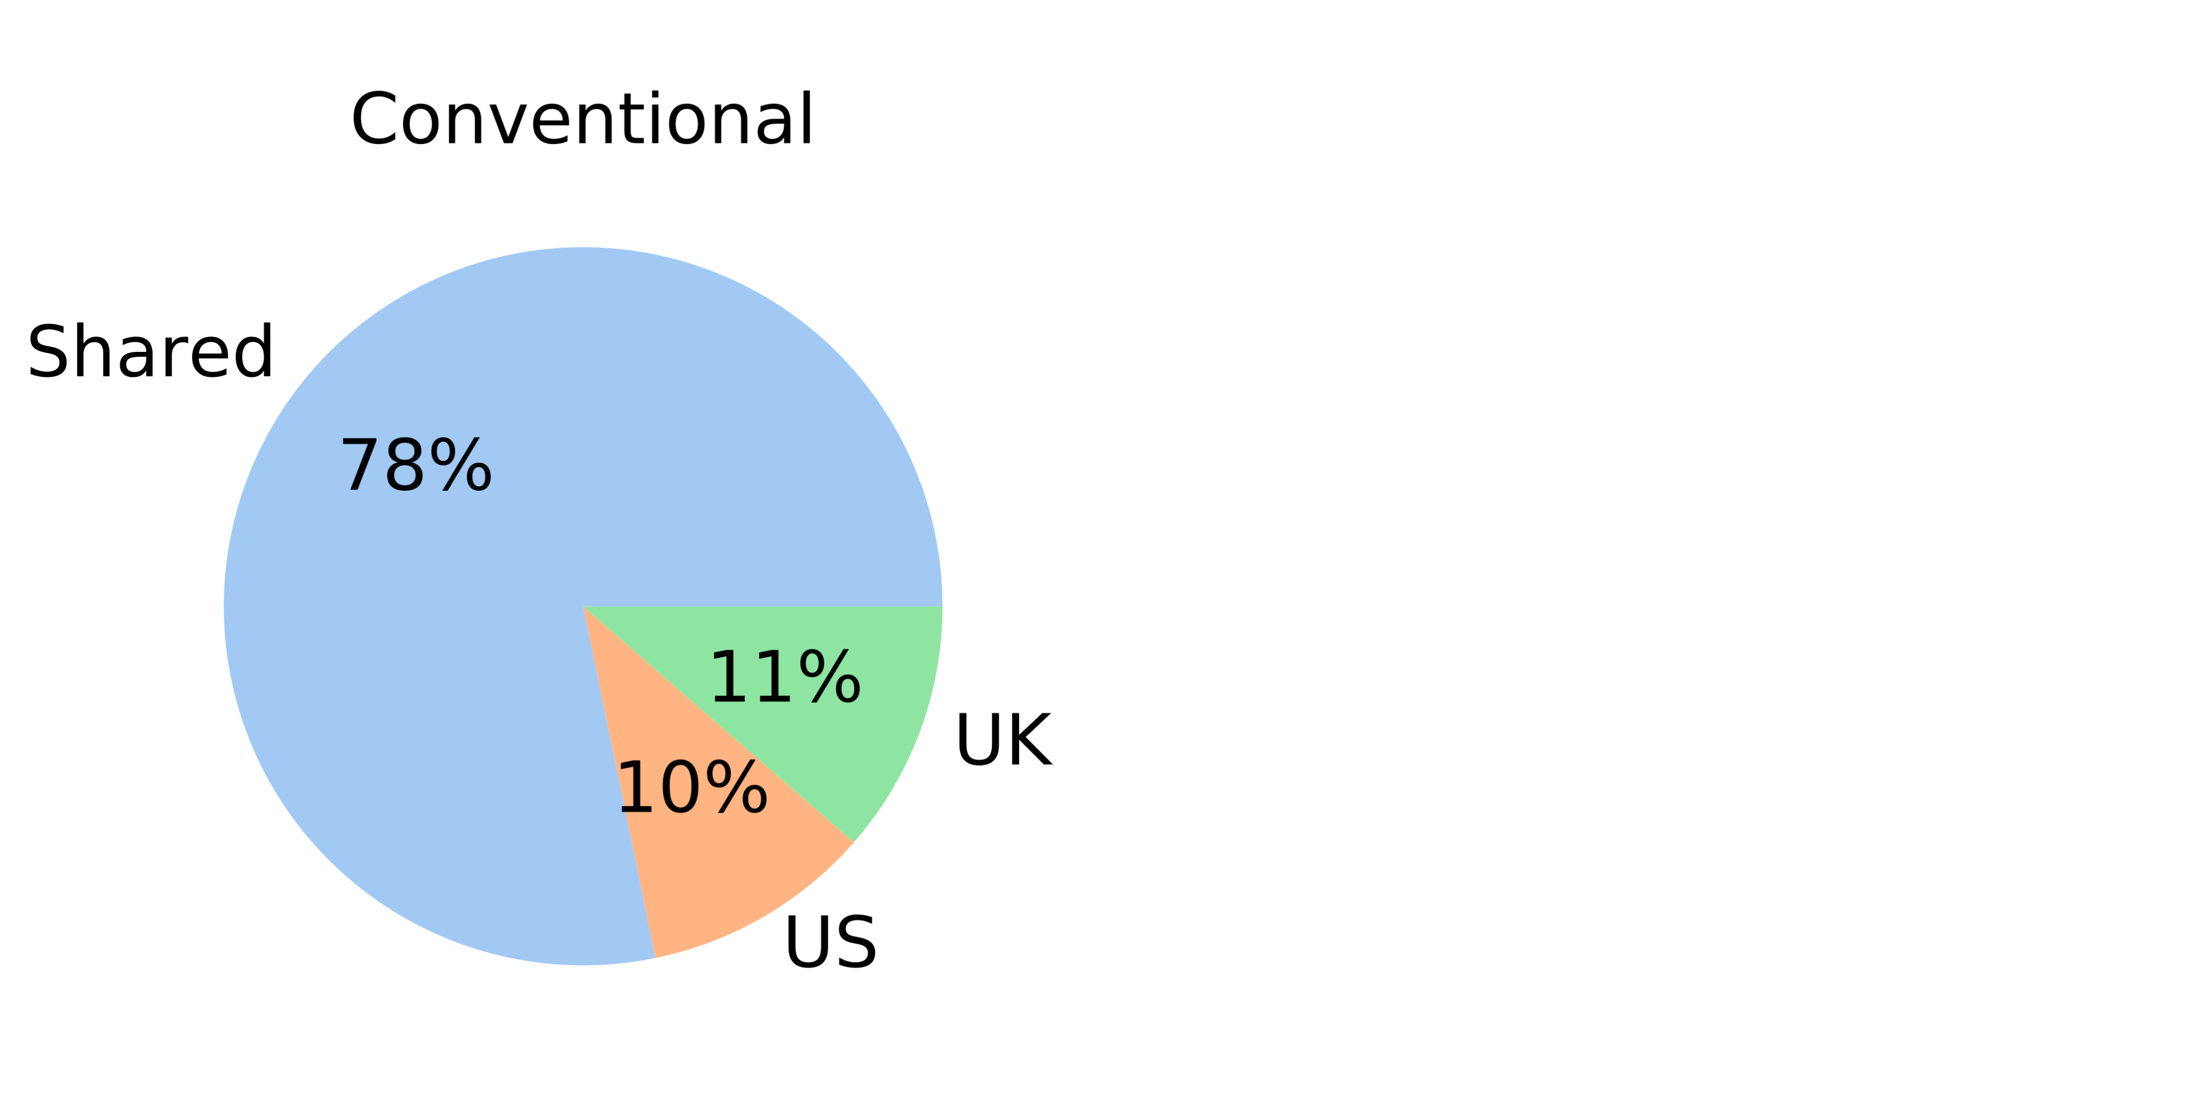
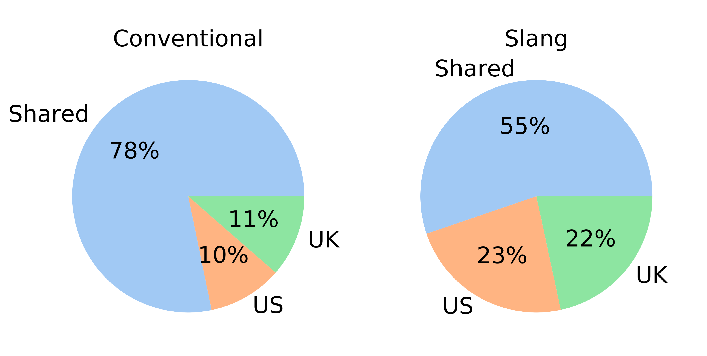
Regional variation in dictionary entries
Regional identities of Wiktionary sense entries:
Slang exhibits much more variation compared to conventional language!

Slide 5
Lexical and semantic variation in slang
We observe similar patterns in Green’s Dictionary of Slang:
Apart from lexical variation, semantic variation of slang is also prominent.
All senses
Word forms
Senses of
shared word forms

Slide 6

Research questions
Lexical variation of internet language.
E.g. Eisenstein et al., 2014; Nguyen et al., 2016
Quantifying semantic variation.
E.g. Del Tredici and Fernandez, 2017; Lucy and Bamman, 2021
But how do slang senses vary across different communities?
What are the driving forces behind this variation?
Does the mode of variation change over time?

Slide 7
Theoretical hypotheses
We consider two theoretical hypotheses for characterizing regularity in slang semantic variation:
Communicative need
The need to communicate different concepts drives variation in meaning (Sornig 1981).
Semantic distinction
The desire to reinforce social identity drives semantic variation in slang (Eble, 2012).

Slide 8
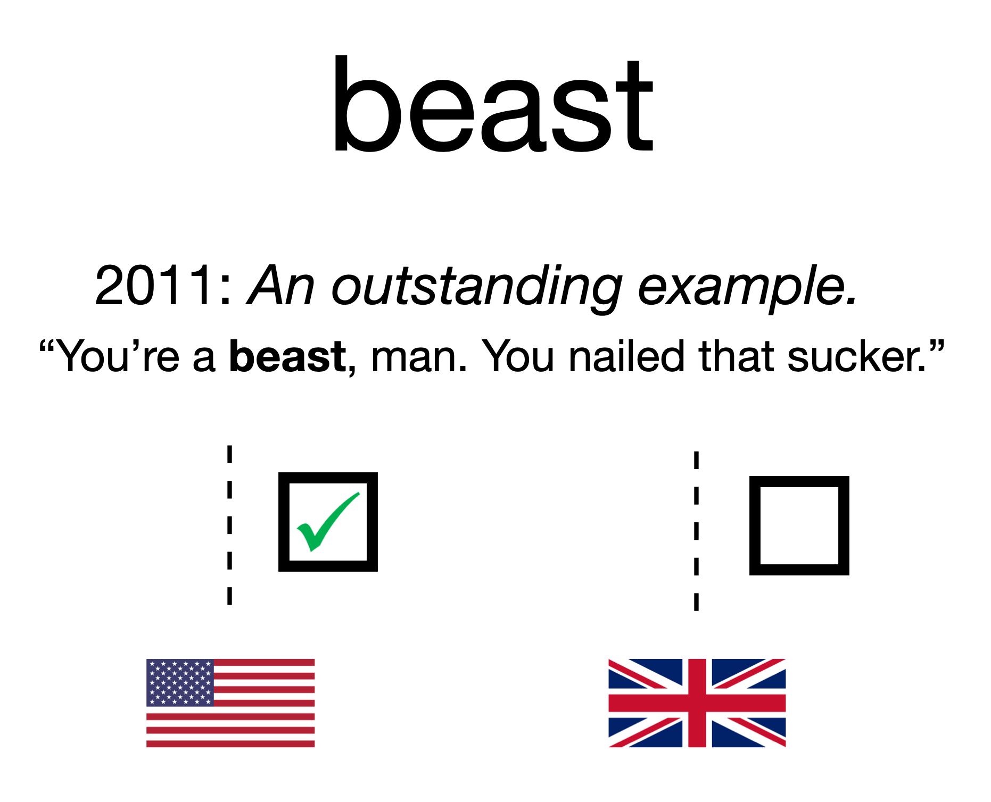
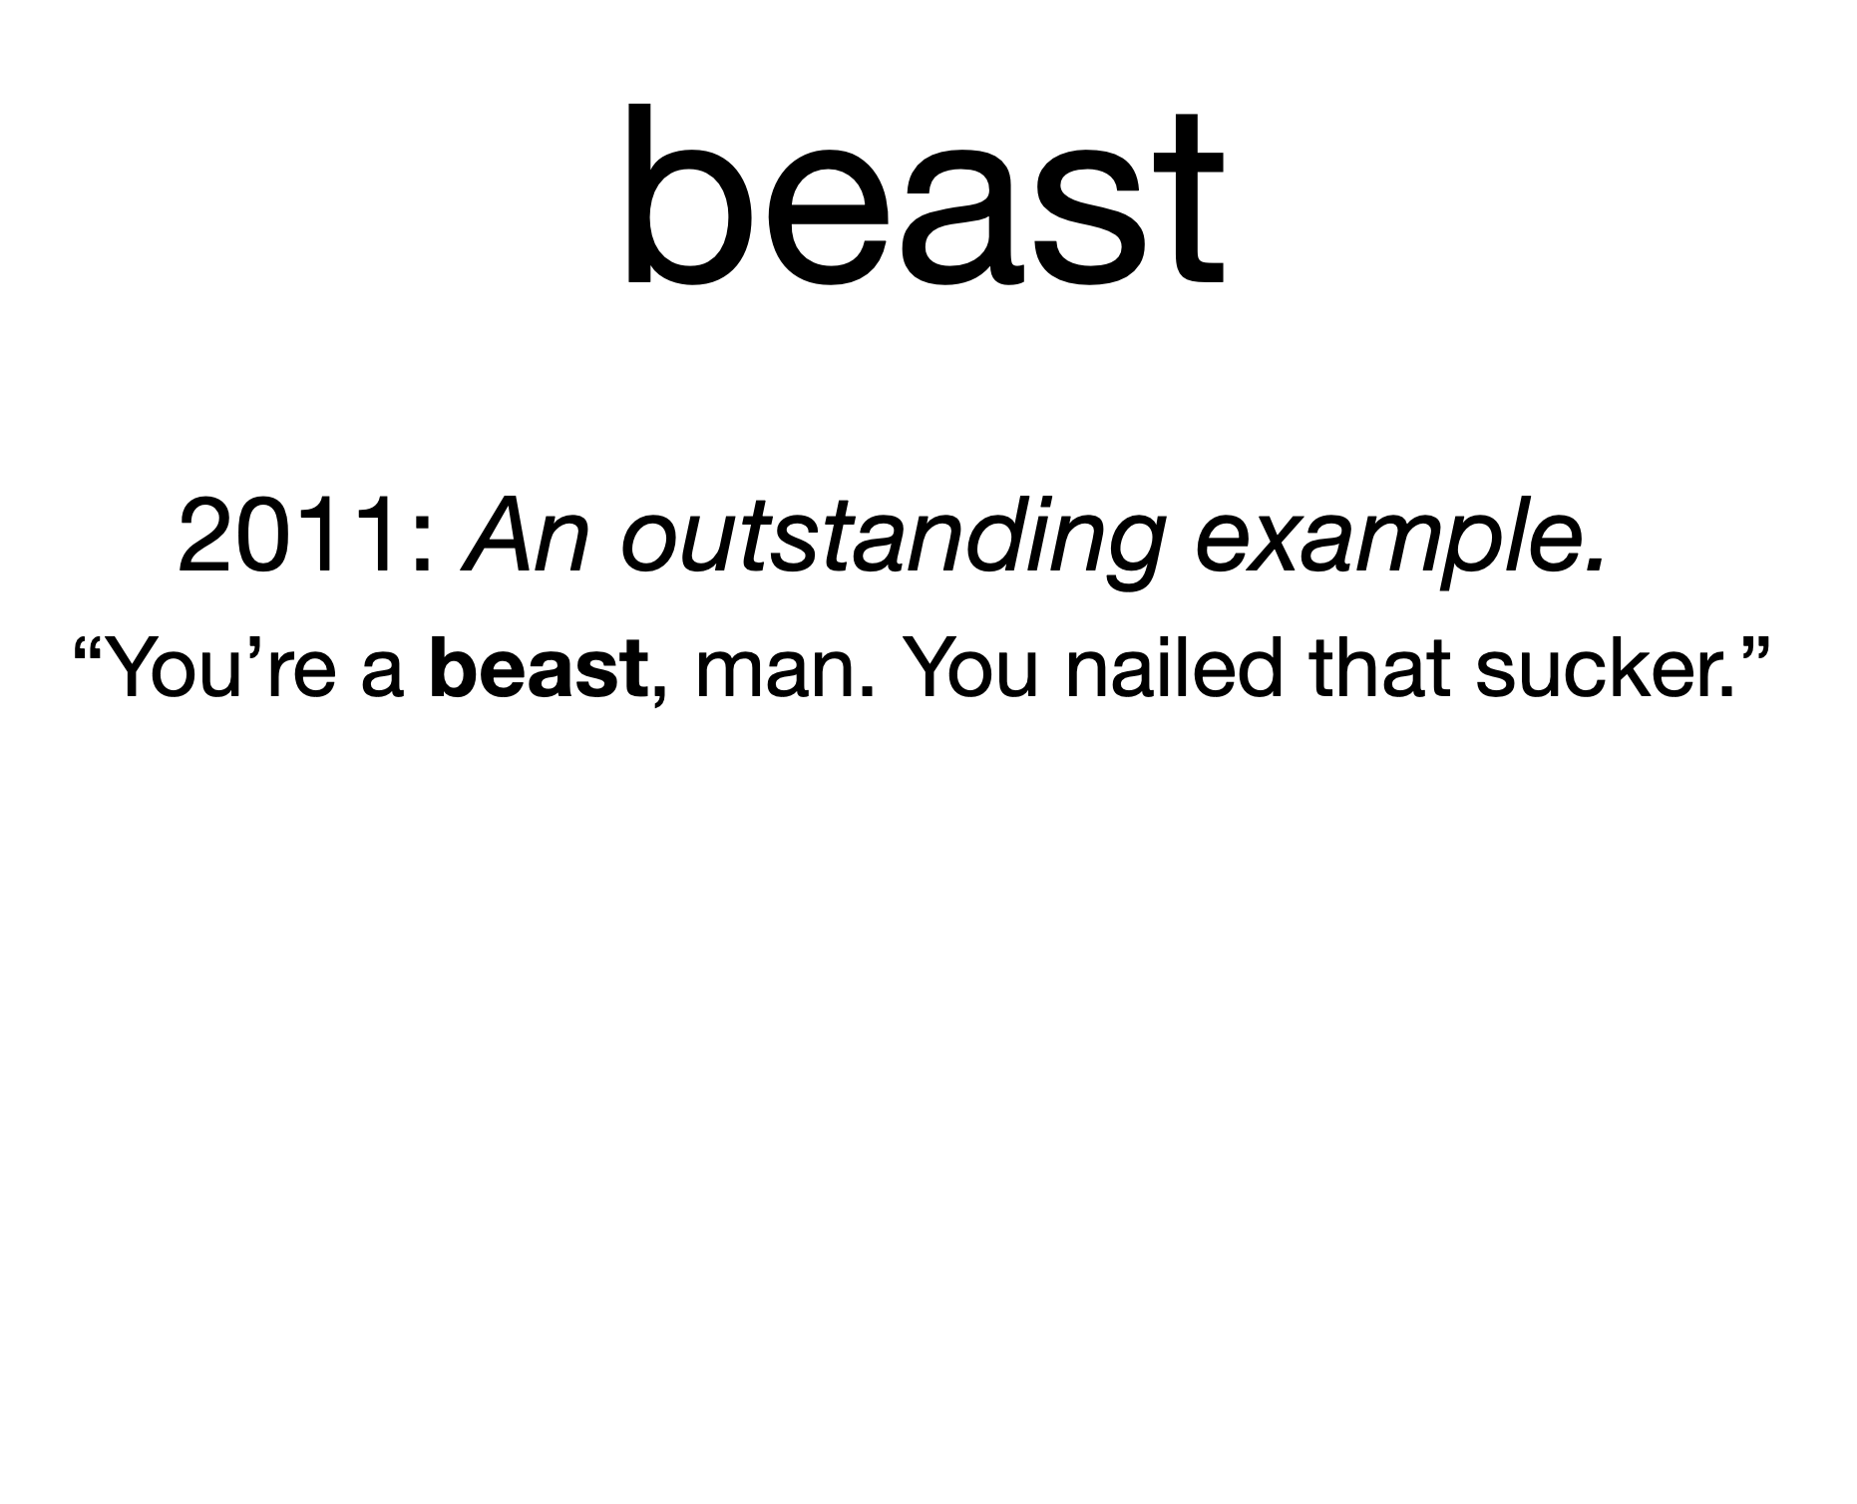
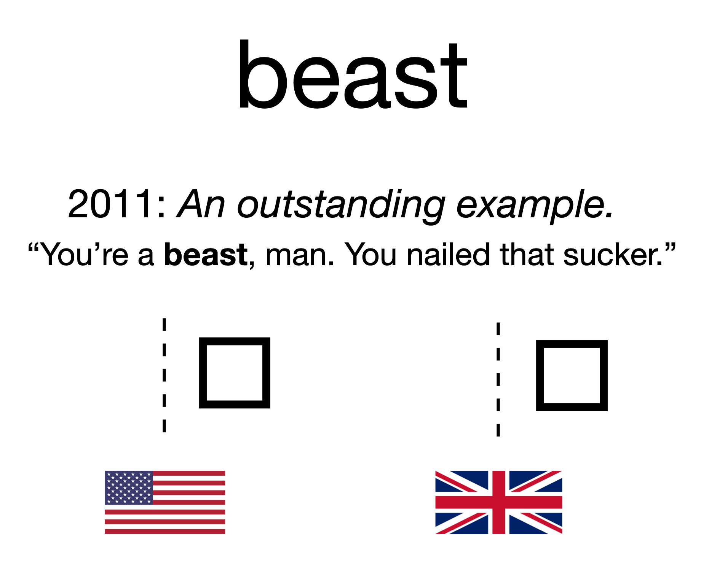
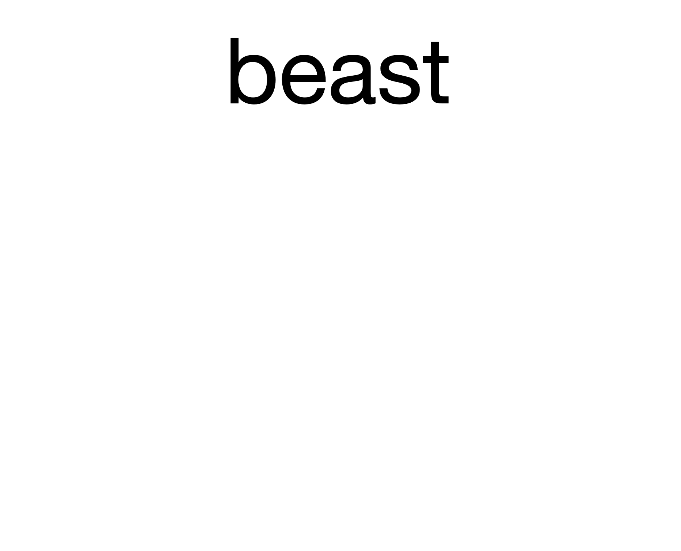
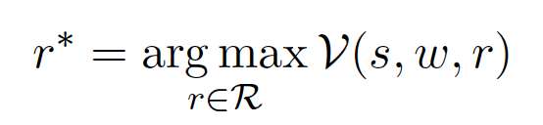
Framework
Build models of regional semantic variation and evaluate on a regional inference task:

Slide 9
Communicative need
Different communities (e.g. US) need to communicate different concepts.
E.g. One of the slang senses for beast is “Subway #2 of NYC”, a meaning that is only relevant to the US.
We define communicative need as how frequently a meaning needs to be communicated or expressed within a community.
Estimate communicative need using frequency counts from historical corpora (Kemp and Regier 2012; Ryskina et al. 2020).

Slide 10
Models based on communicative need
Estimate need probabilities using region-specific frequency counts from Google Ngram in a 10-year window.
Three types of frequency estimates:
Form: The slang word form itself. E.g. beast
Semantic: Content words in the sense’s definition sentence.
E.g. An outstanding example.
Context: Content words in the sense’s example usage sentence.
E.g. You’re a beast man, you nailed that sucker.

Slide 11
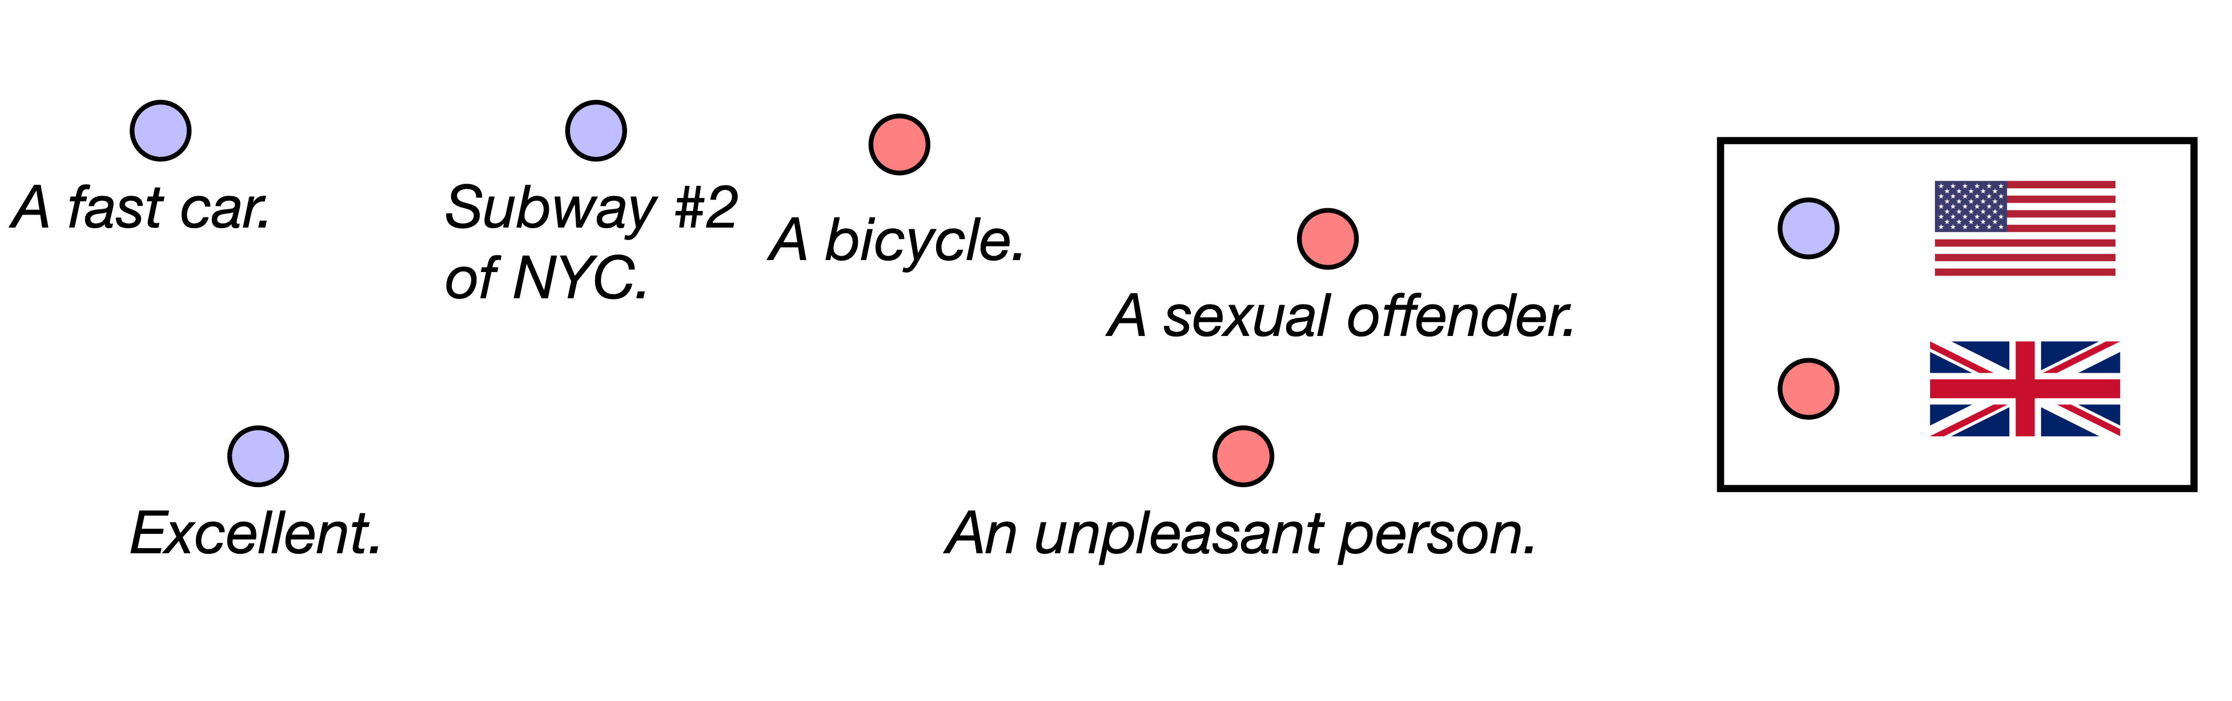
Semantic distinction
Motivated by social functions of slang (Labov, 1972; Hovy 1990).
Each community forms a semantically cohesive set of meanings that reflects its cultural identity.

Slide 12
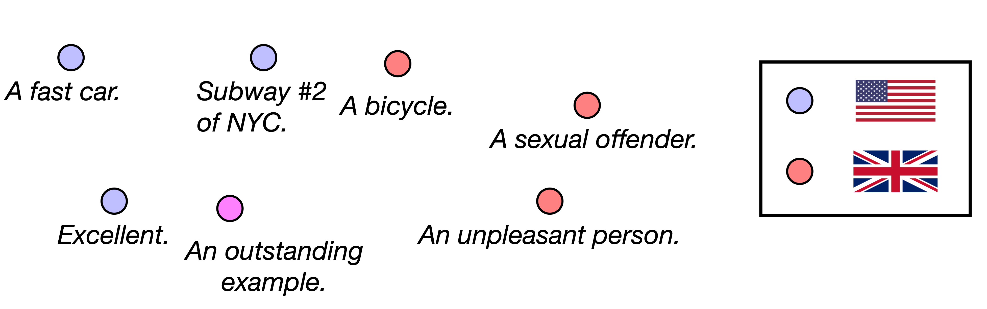
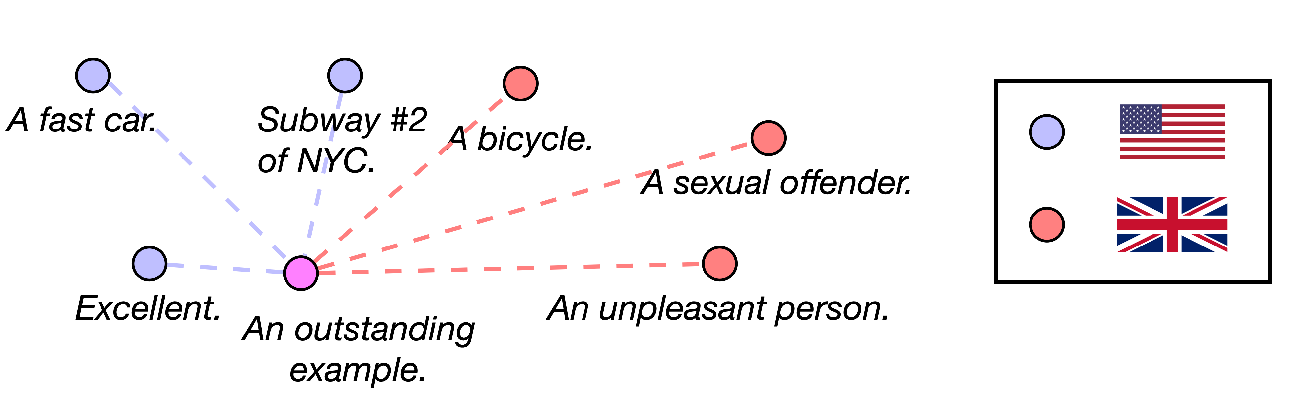
Semantic distinction
We operationalize semantic distinction by models of semantic chaining (Ramiro et al., 2018; Habibi et al., 2020).

Slide 13
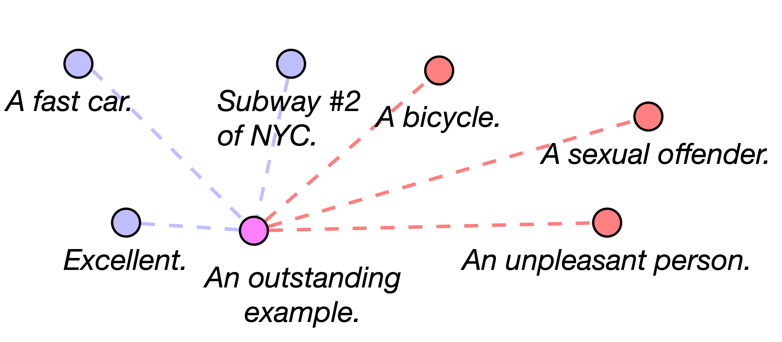
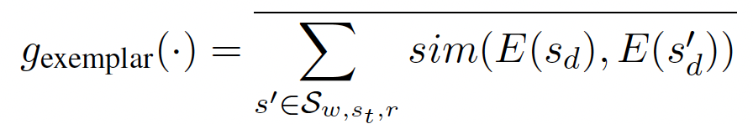
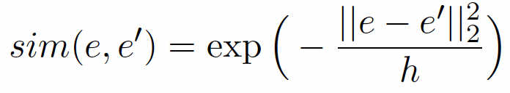
Models based on semantic distinction
Embed each sense’s definition sentence using Sentence-BERT.
Score each region by measuring the proximity of the queried sense w.r.t. historical senses attested in each region:
Exemplar model

Slide 14
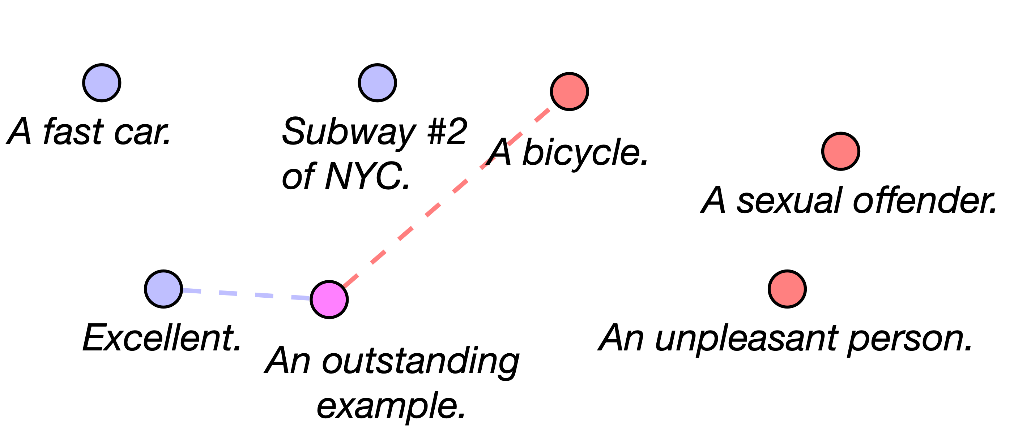
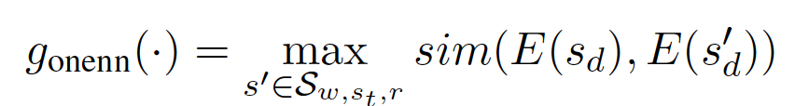
Models based on semantic distinction
Embed each sense’s definition sentence using Sentence-BERT.
Score each region by measuring the proximity of the queried sense w.r.t. historical senses attested in each region:
One-Nearest-Neighbor model

Slide 15
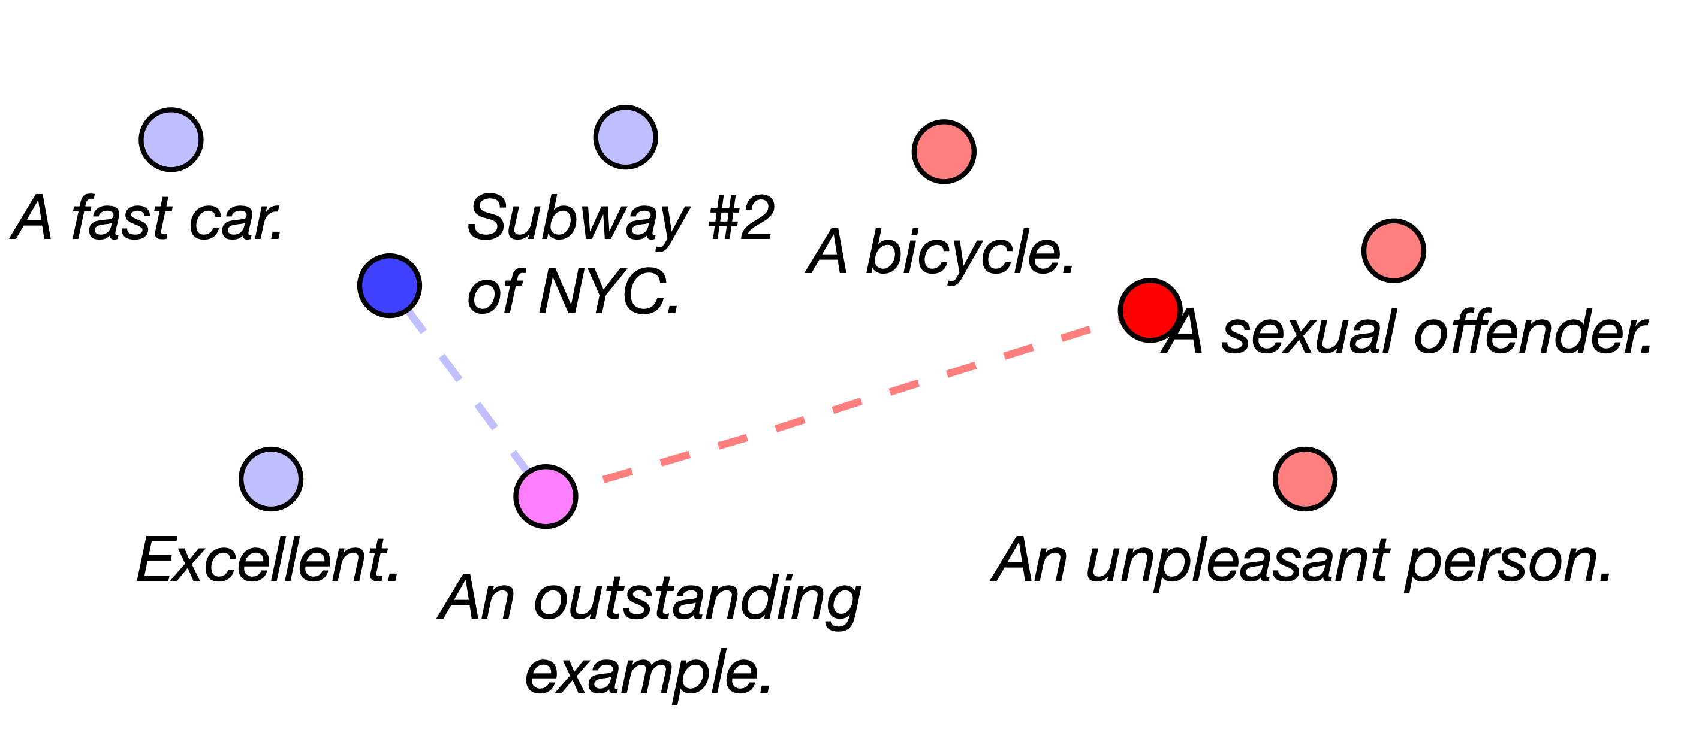
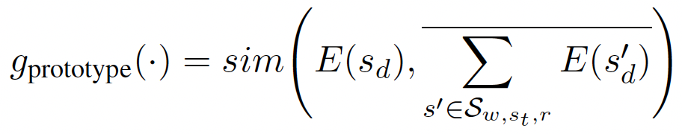
Models based on semantic distinction
Embed each sense’s definition sentence using Sentence-BERT.
Score each region by measuring the proximity of the queried sense w.r.t. historical senses attested in each region:
Prototype model

Slide 16
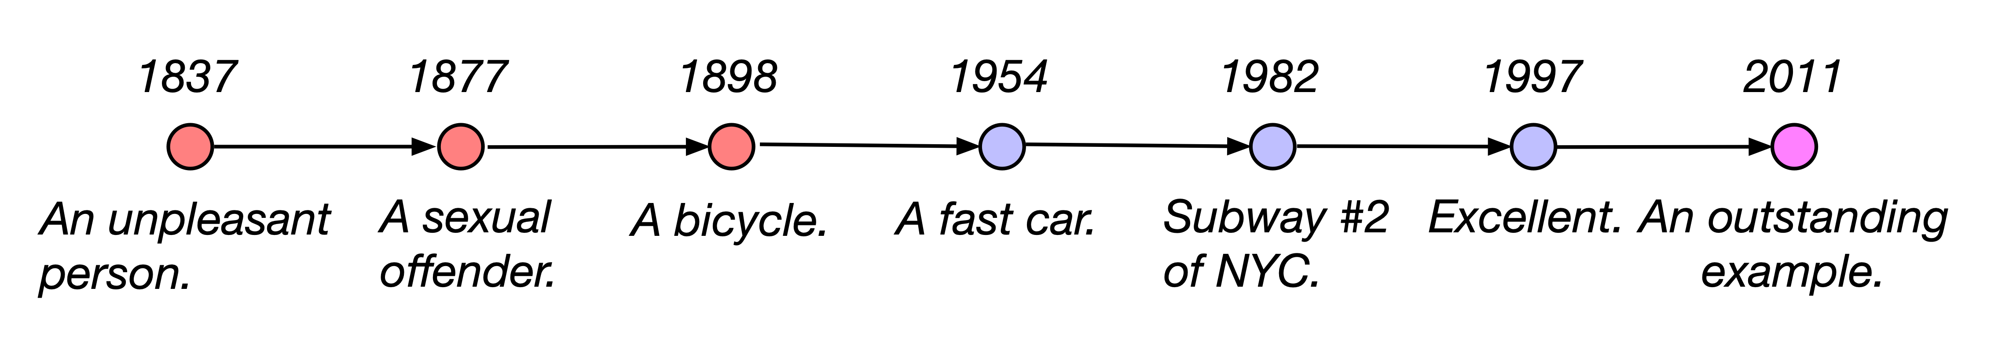
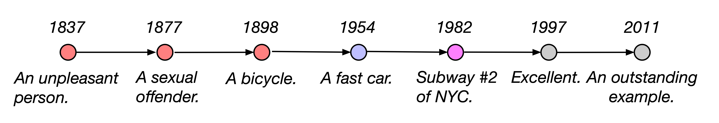


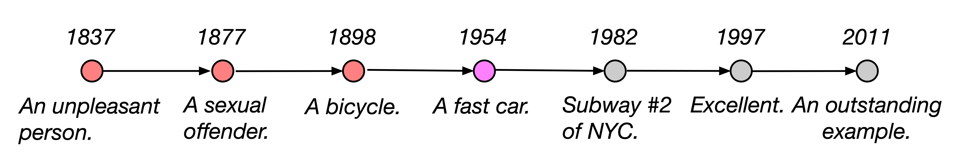
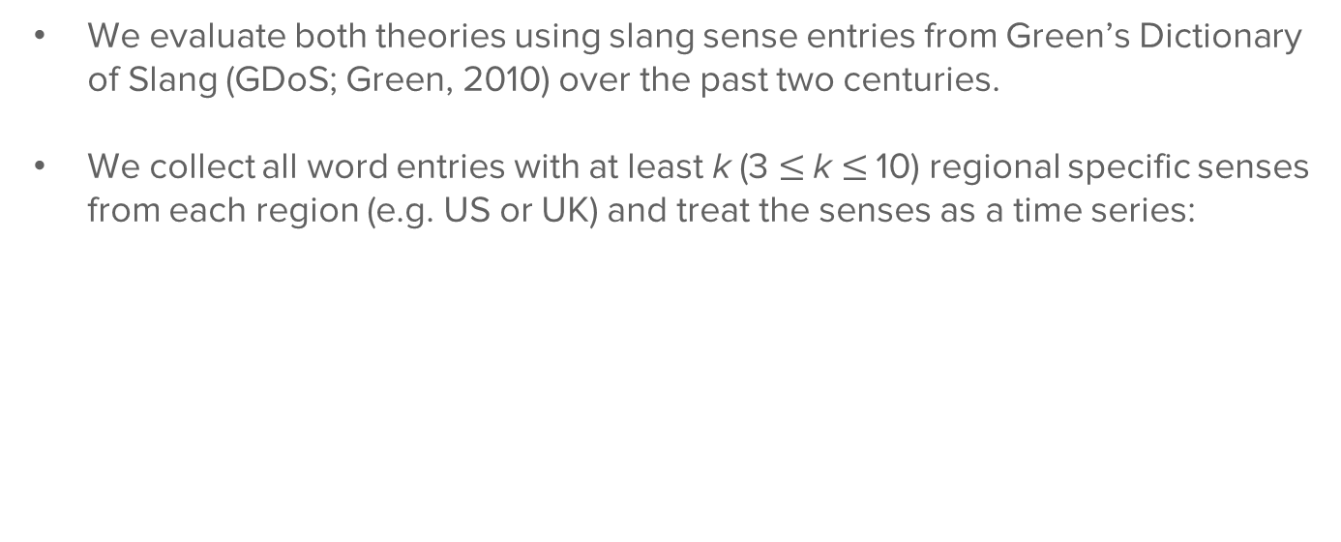
Experiment
We evaluate both theories using slang sense entries from Green’s Dictionary of Slang (GDoS; Green, 2010) over the past two centuries.
We collect all word entries with at least k (3 $≤$k $≤$10) regional specific senses from each region (e.g. US or UK) and treat the senses as a time series:

Slide 17
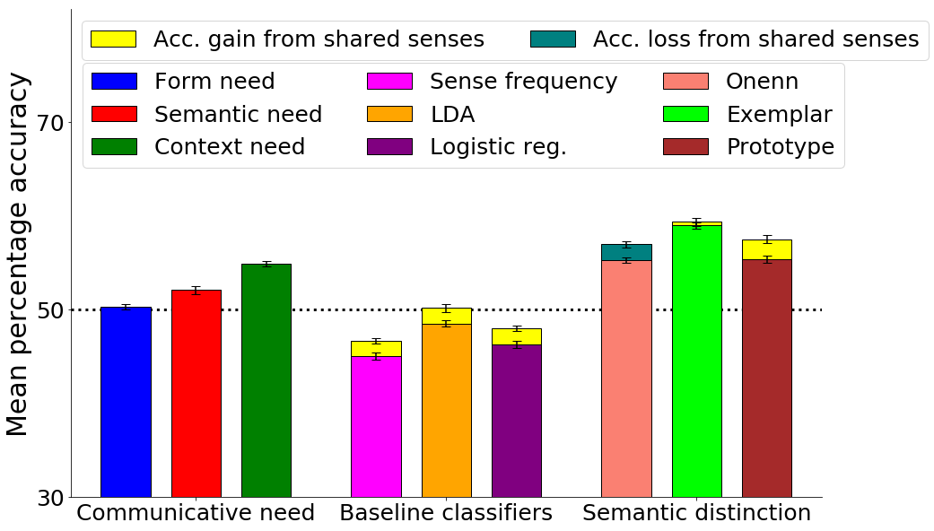
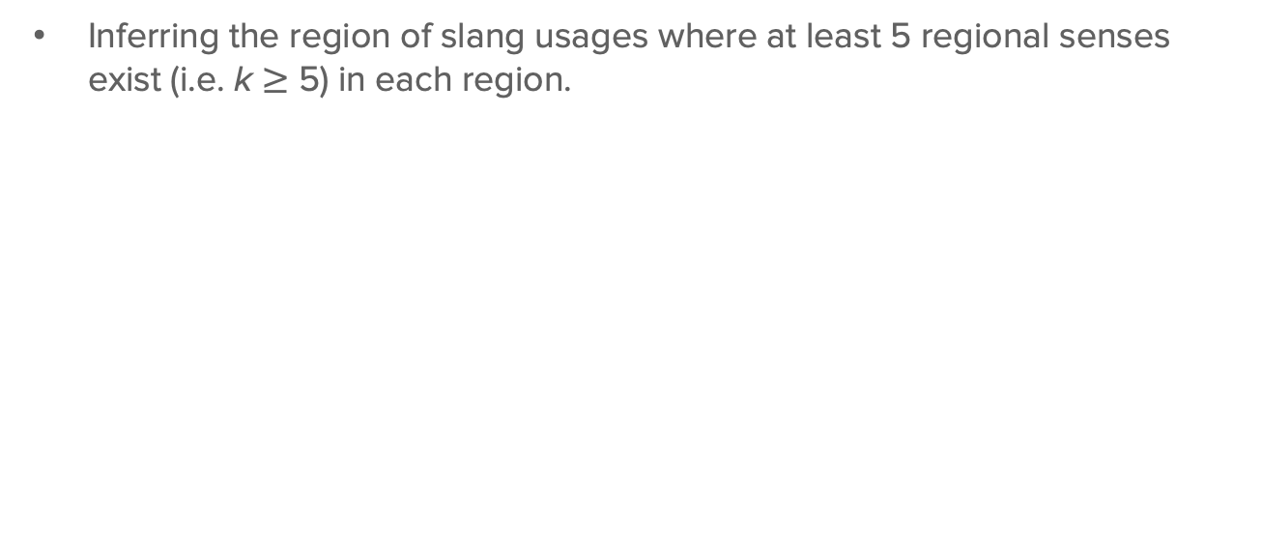
Results
Inferring the region of slang usages where at least 5 regional senses exist (i.e. k $≥$ 5) in each region.

Slide 18
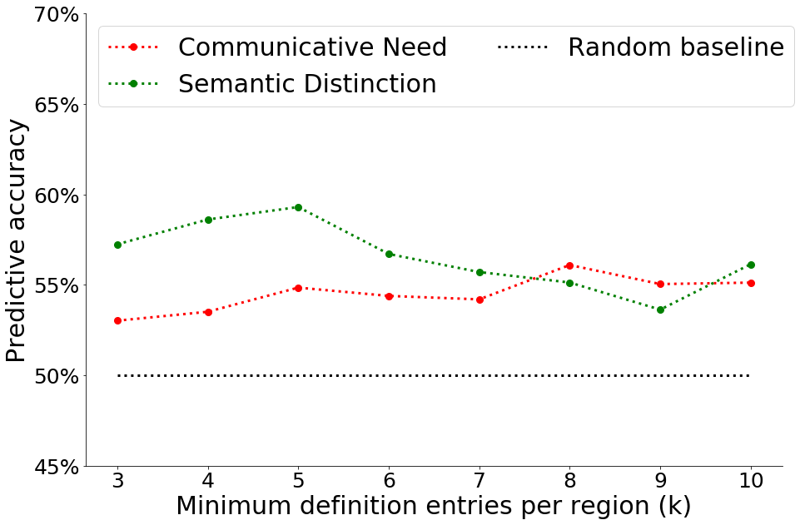
Results
Performance advantage of semantic distinction models over need based models wane as slang becomes more polysemous:

Slide 19
Results
Slang senses from over 100 years ago remain relevant in modeling semantic variation of contemporary slang.
The relative importance of communicative need and semantic distinction fluctuates over history.
Detailed results in the paper!
Notes:
Example data entry

Slide 20
Conclusion
We have presented the first principled large scale analysis of slang semantic variation over history.
Both theories of communicative need and semantic distinction are relevant in predicting slang semantic variation.
Future work can leverage such structure to incorporate historical-cultural elements in slang NLP.
Notes:
Example data entry

Slide 21
Thank you!
Code and data: https://github.com/zhewei-sun/slangsemvar
Link to paper: https://arxiv.org/abs/2210.08635
Contact:
Zhewei Sun
Department of Computer Science
University of Toronto
zheweisun [at] cs.toronto.edu
http://www.cs.toronto.edu/~zheweisun/
Notes:
Example data entry

